Slide 1
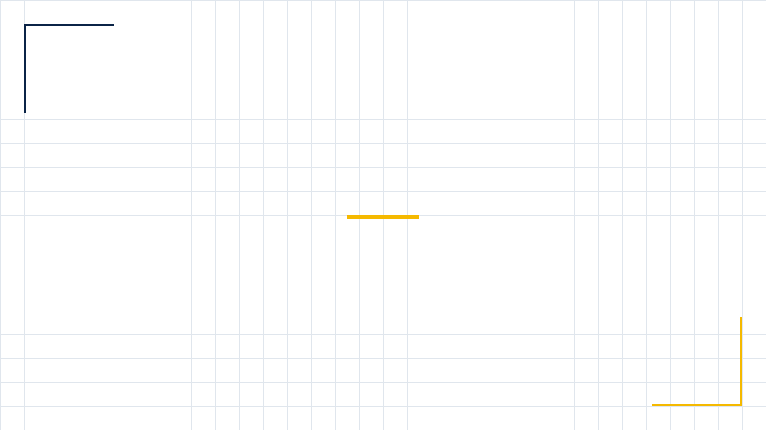
MODEL: LC-LED-AAA-300S
Lecheng Intelligent LED Solar Simulator
The Ideal Choice for Perovskite Photovoltaic Testing
Lecheng Intelligent

Slide 2

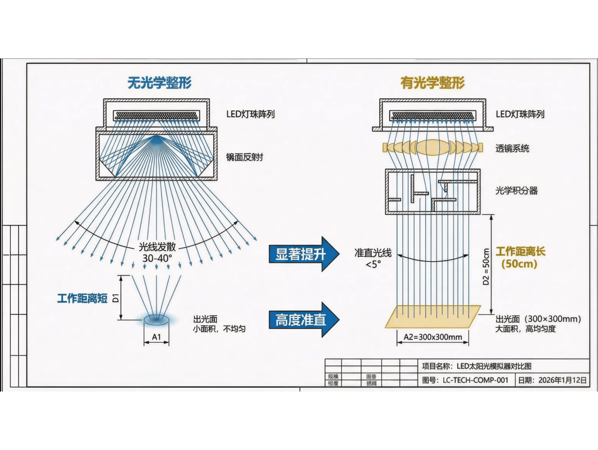
Core Technical Advantages Optical Shaping System for More Accurate Testing
Competitor Limitations
• Lack of optical shaping, direct LED emission
• 30-40° light divergence, non-parallel light
• Short working distance, small/non-uniform area
Lecheng Intelligent's Breakthrough
• Complete optical shaping: Lens + Integrator
• Collimation angle < 5°, true parallel sunlight
• 50cm working distance, 300mm uniform spot
Indicator
Competitor
Lecheng (LC-LED-AAA-300S)
Collimation
30-40° (Divergent)
< 5° (Collimated)
Working Dist.
Short
50 cm
Area
Small/Non-uniform
300 × 300 mm (Class A)
* Diagram text in Chinese; see left for English details

Slide 3
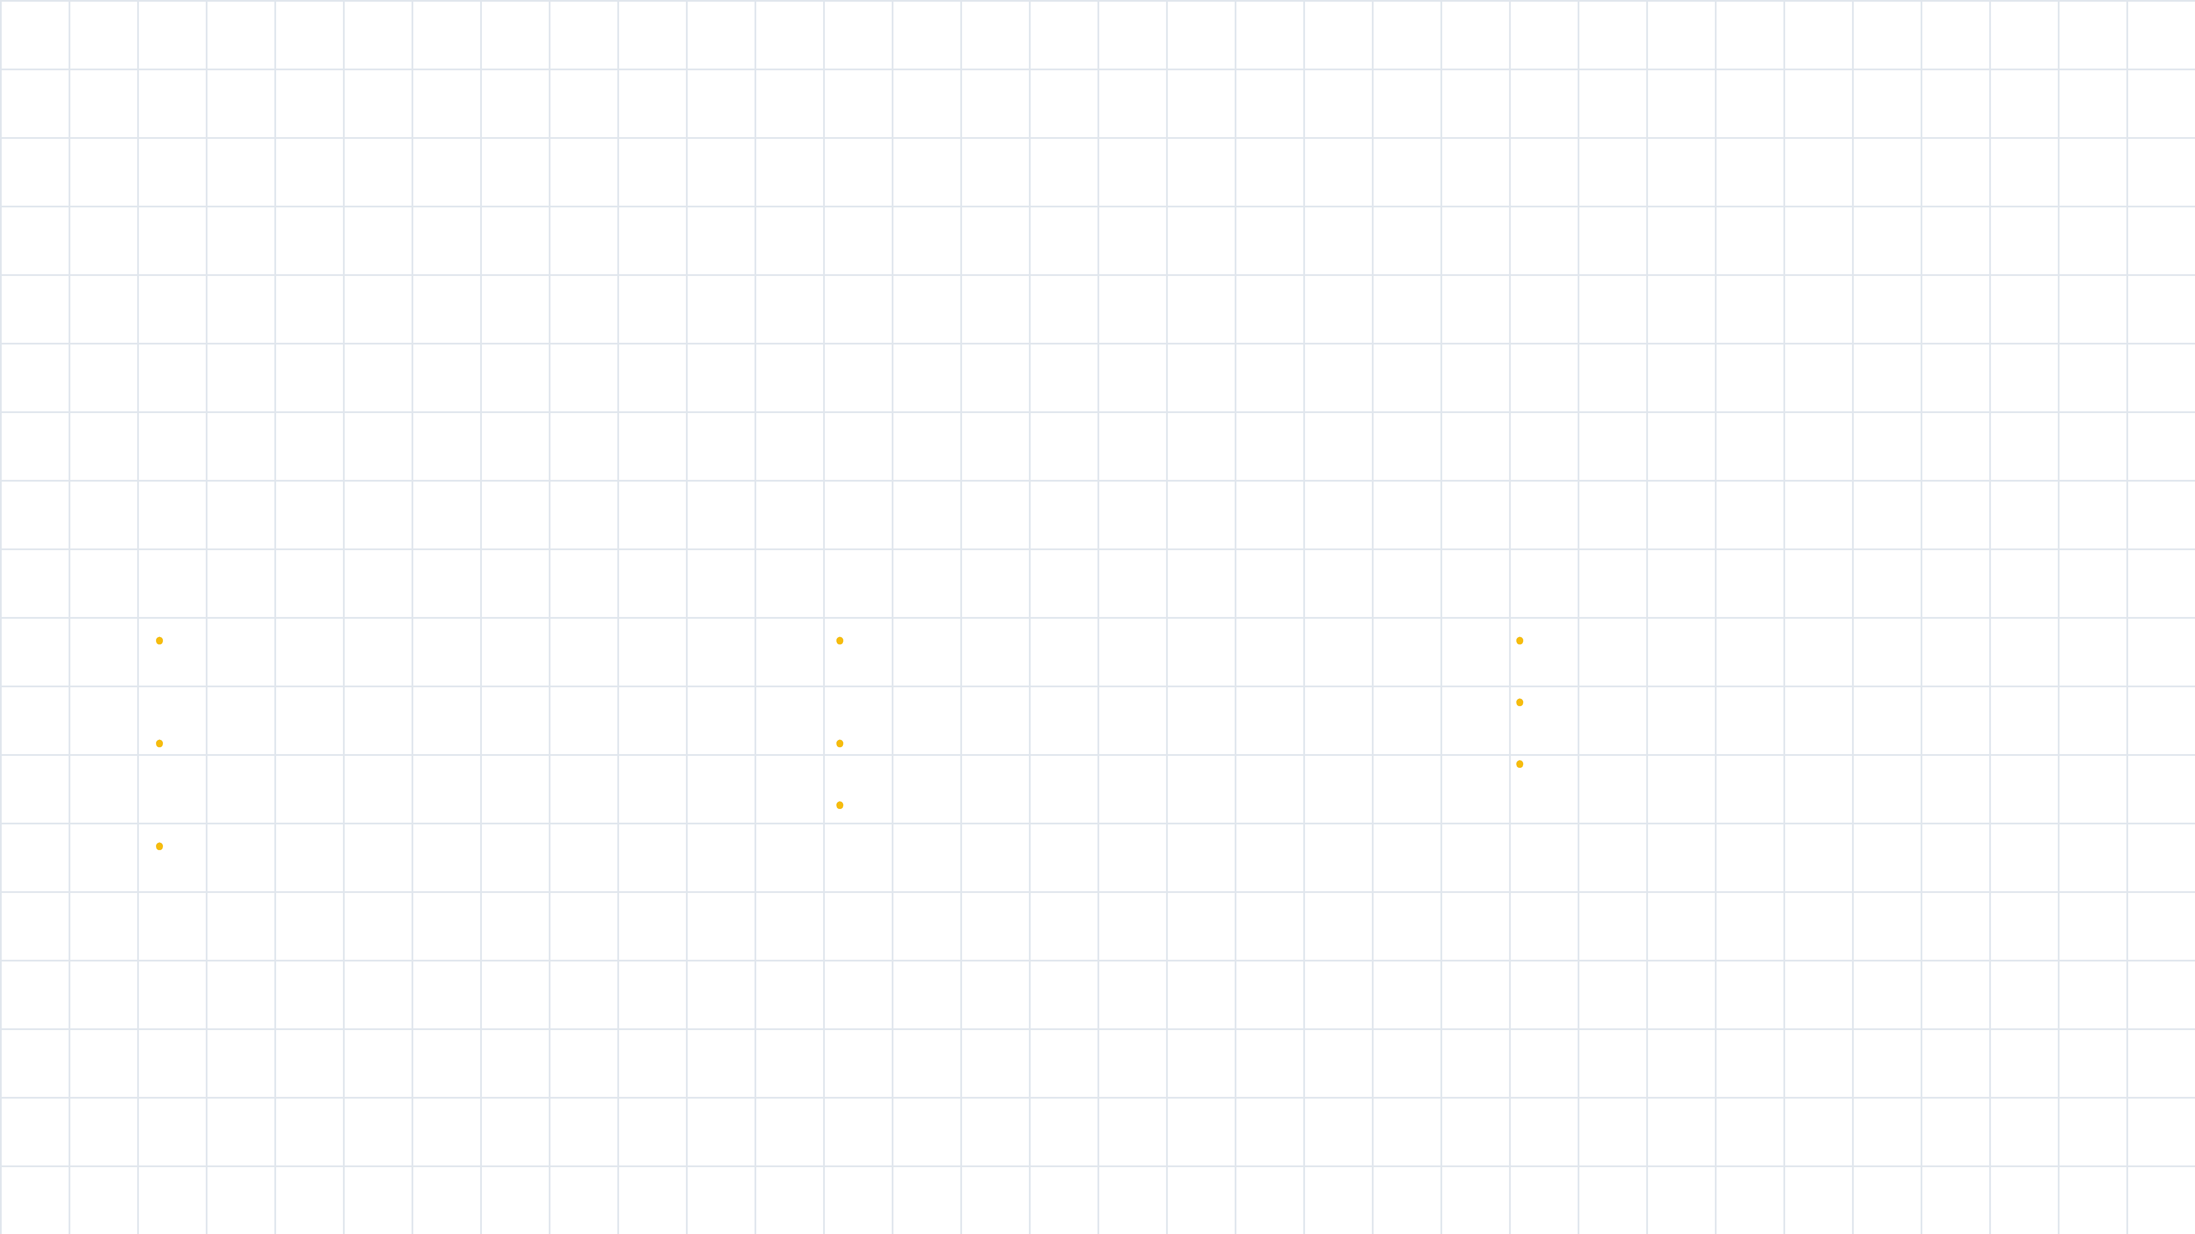
International A+ Standard Certification Performance Exceeding Industry Requirements
The product has been rigorously tested by third-party authoritative institutions, with all core indicators meeting or exceeding the highest requirements of IEC 60904-9 Edition 3 international standards.
Spectral Match
A+
Irradiance Uniformity
A
Temporal Stability
A+
•
Coverage: 350nm - 1200nm full spectrum.
•
Effective irradiation area: 300 × 300 mm.
•
Short-term stability ≤ 0.25%.
•
Long-term stability ≤ 1%.
•
All six key wavelength bands achieve A+ standard.
•
Non-uniformity ≤ 2%.
•
Supports transient pulse (>200ms) and steady-state continuous (24-1000h) testing.
•
Ensures consistency in large-area device testing.
•
Ensures accurate spectral response testing for perovskite materials.
Test Standard: IEC-60904-9-2020
Report Number: alsolute-2025X
Overall Rating:A+

Slide 4

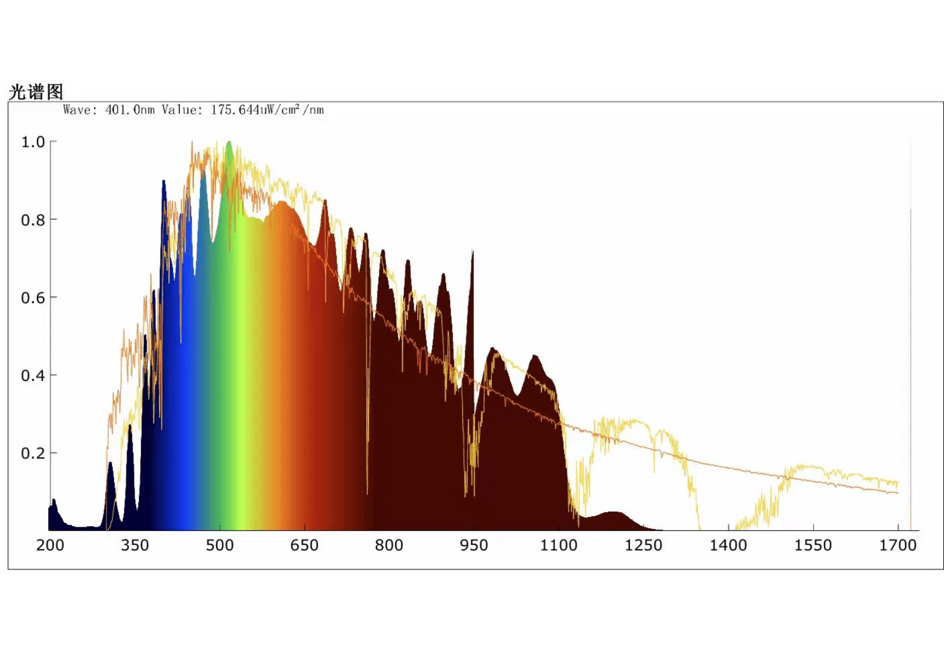
Precise Spectral Reproduction Designed Specifically for Perovskite Photovoltaics
LC-LED-AAA-300S covers a broad spectral range from 350nm to 1200nm, perfectly matching the full-band absorption characteristics of perovskite solar cells from ultraviolet to near-infrared.
Wavelength Band (nm)
Measured Ratio
Grade
300 - 470 (UV-Blue)
1.0030
A+
470 - 561 (Blue-Green)
1.0241
A+
561 - 657 (Green-Yellow)
1.0311
A+
657 - 772 (Red)
1.0375
A+
772 - 919 (Near-IR)
0.9783
A+
919 - 1200 (Near-IR)
0.9261
A+
Measured Spectral Chart: Highly consistent across all bands

Slide 5






Flexible Testing Capabilities Meeting Multi-Scenario R&D Requirements
Wide-Range Irradiance
Transient Pulse Mode
Pulse > 200ms
0.3 ~ 1.2 sun
Suitable for rapid I-V characteristic measurements, effectively avoiding the impact of device overheating on test results.
300 - 1200 W/m² Continuously Adjustable
1.2 sun (High Intensity)
Device tolerance testing
Steady-State Continuous Mode
24h - 1000h
1.0 sun (STC)
Specifically designed for long-term stability testing and aging experiments, meeting perovskite device lifetime evaluation requirements.
Standard efficiency calibration
0.3 sun (Low Light)
Indoor/low-light performance evaluation
10,000+ Hours
Water Cooling
LED Light Source Lifetime
Standard Industrial System

Slide 6
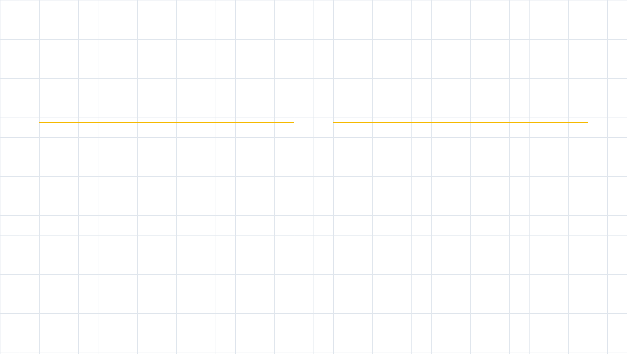











Complete Solution Comprehensive Support from Equipment to Service
Turnkey System Configuration
Professional Service Guarantee
Main System
Installation & Training
LC-LED-AAA-300S Solar Simulator Host
Free on-site installation, commissioning, and operation training
Power System
Technical Support
Standard 5000W isolation transformer, ensuring power stability
Instant phone support on working days, answering technical questions anytime
Cooling System
Standard industrial-grade water chiller, ensuring stable long-term operation
Rapid Response
48-hour on-site service commitment, reducing downtime
Optical System
Quality Assurance
Built-in optical integrator and multiple lens groups, collimation angle < 5°
One-year free warranty for the entire machine, long-term supply guarantee for core components
Application Environment Recommendations: To ensure optimal performance, it is recommended to use in a constant temperature and humidity environment with air conditioning, with ambient temperature preferably not exceeding 25℃.

Slide 7





Why Choose Lecheng Intelligent?
Technology Leadership
Professional Focus
Flexible & Reliable
Comprehensive Service
International A+ standard certification Optical shaping system ensures testing accuracy
Designed specifically for perovskite PV applications Precise spectral matching across all bands
Dual-mode operation, wide-range adjustment 10,000-hour ultra-long lifetime
From installation training to after-sales maintenance Full-range professional support
Lecheng Intelligent
Let us work together to drive innovation and development in perovskite photovoltaic technology

Slide 8

Get in Touch
Looking forward to creating the future with you
Tel
+86-153-2185-6437
Email
wj.yan@lcintel.com
Address
苏州市常熟经开区科创园5号楼
钙钛矿检测领域最专业、最高效的智能化解决方案。
Lecheng Intelligence Technology (Suzhou) Co., Ltd.
Lecheng Intelligence Technology (Suzhou) Co., Ltd.

