Slide 1
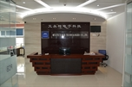
PCBA Subsidiaries Your Best Partner
Multech PCBA subsidiaries are located in Shenzhen, Huizhou. We are dedicated to providing one-stop services that also includes SMT, DIP soldering, assembly ,testing and box building. Our factories have 20 SMT lines equipped with FUJI pick and place machine, solder paste printers, 10 temperature zones reflow ovens, wave soldering, BGA rework platform, etc.
Multech provides the best flexible manufacturing solutions for prototype, medium and small volume orders.
20 SMT lines in Shenzhen, Shanghai and Chengdu factories
FUJI XPF/NXT III /AIMEX III, AOI, SPI, XRAY, First Article Inspection
1,600㎡ R&C warehouse with 10,000+ kinds of R&C in stock
Inductor, ferrite beads and connector in stock
Min SMD: 03015, 01005, 0201, 0.35mm BGA

Slide 2
PCBA Factories

Slide 3
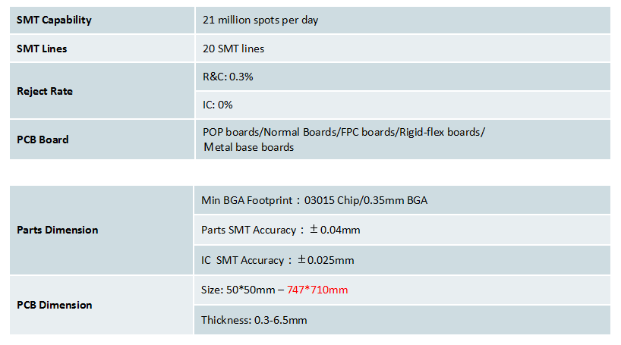
PCBA Capability
单击输入您的封面副标题

Slide 4
PCBA Production Line

Slide 5
PCBA Factory Facilities

Slide 6
PCBA Factory Facilities

Slide 7
Parts Purchasing

Slide 8
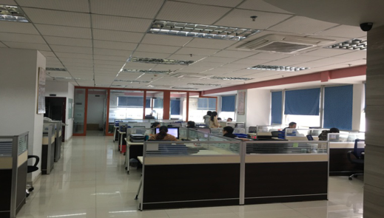
Supply-chain
50+ staff focusing on parts sourcing
23+ years part sourcing experience
Project Dept., Engineering Dept., Sourcing Dept., QC Dept., Custom Dept.
Professional component validation engineers
Professional BOM engineers

Slide 9
Warehouse

Slide 10
Parts Quality Control

Slide 11
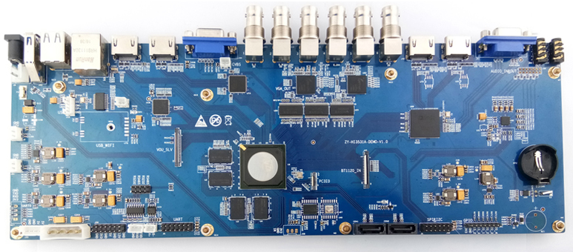
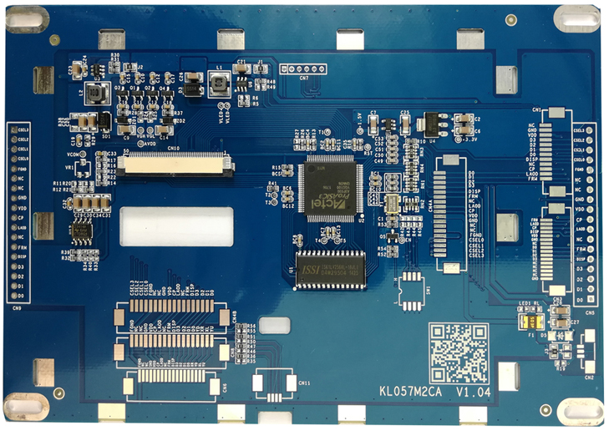
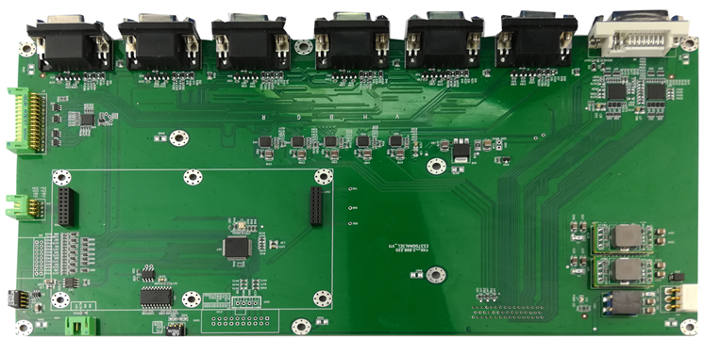
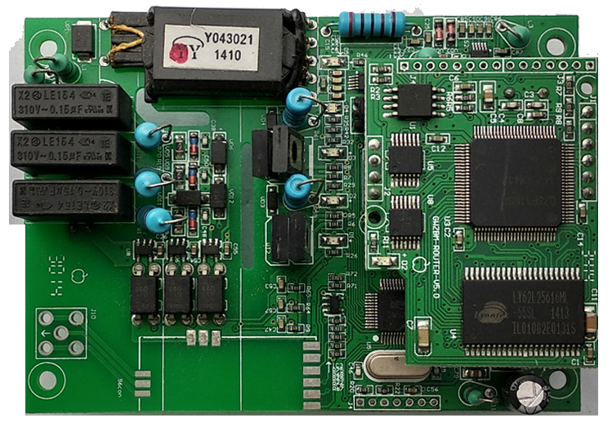
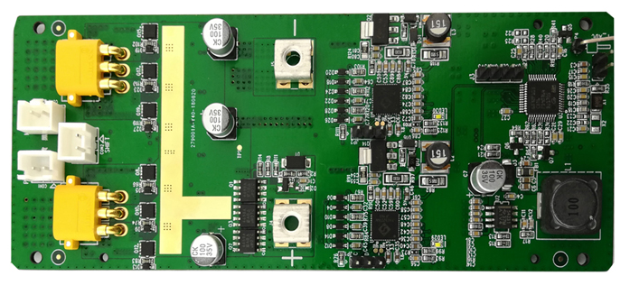
PCBA

Slide 12
Pain Points of Parts Sourcing

Slide 13
Buy On Demand

Slide 14
You may confuse you will have to...

Slide 15
Quality Assurance

Slide 16
Multech, help you save costs, time & efforts

Slide 17
From idea to production!

Slide 18
Partners

Slide 19
Contact
Address:701-708,ShiYuan Building2,FengHuang Garden,BaiShiXia Community, FuYong Street,Baoan district,ShenZhen,China
ShenZhen factory : Yanchuan Industrial,Songgang,Bao'an,Shenzhen China. Huizhou factory : Longshan Road, west area,da ya wan,Huizhou City,Guangdong,China
Phone:+86-755-66828019-888
Mobile phone:+86(0)13828754294
E-mail:Steven@multech-pcb.com
Website:www.multech-pcb.com
www.multech-group.com

